Slide 1
MODULE 2
How to spot health hoaxes

Slide 2
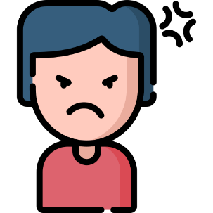
HOW DO HOAXES GO VIRAL?
Hoaxes usually spread quickly because they prey on our emotions

Slide 3
HOW DO HOAXES GO VIRAL?
Health hoaxes prey on:
Our fear of illness and death
Hope for finding a solution

Slide 4
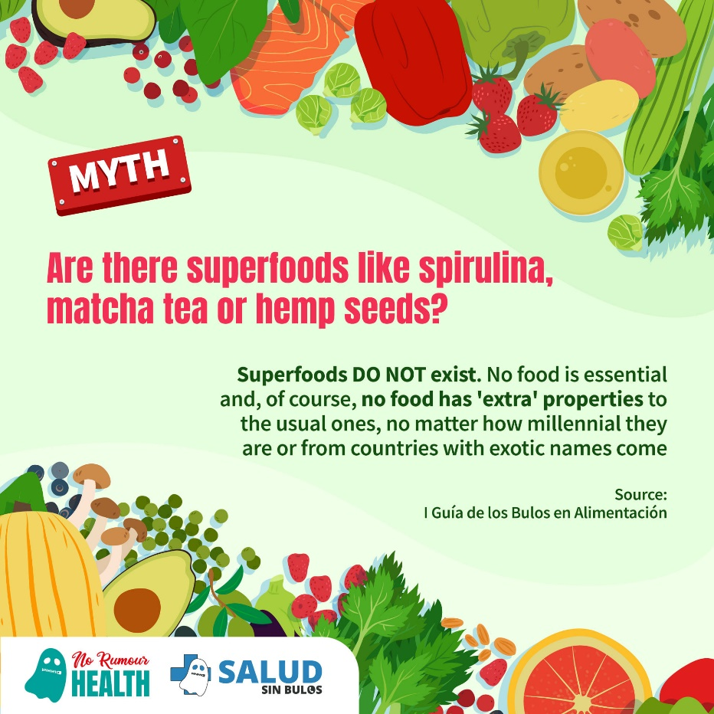
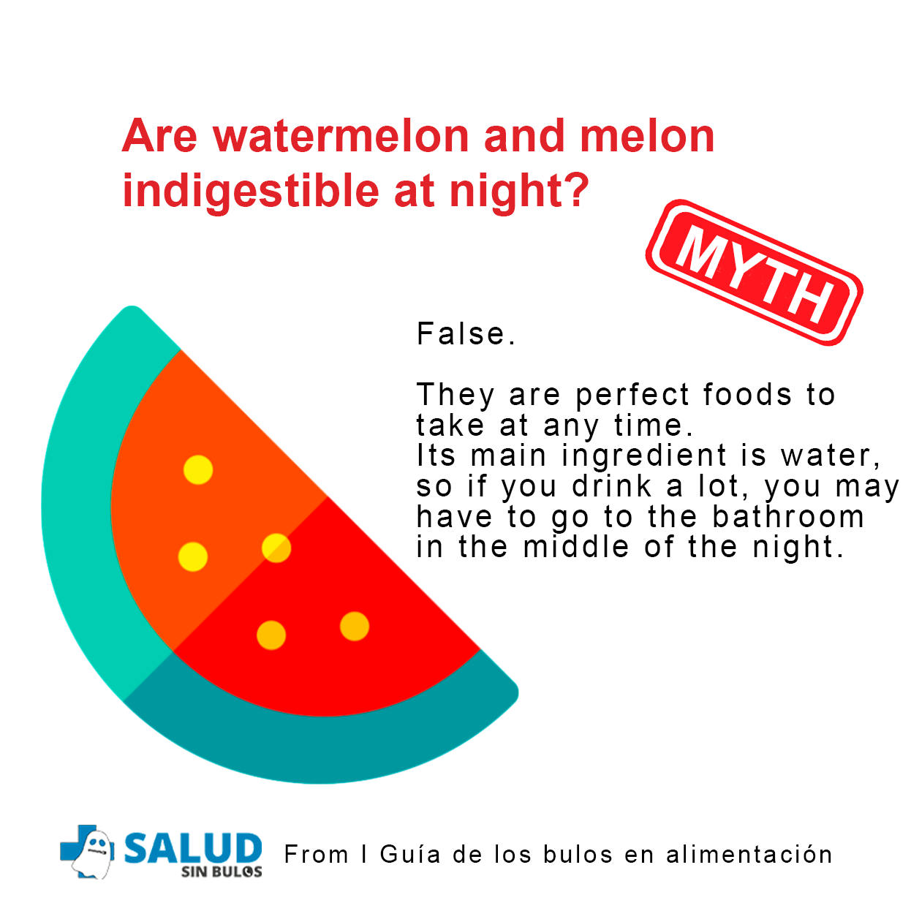
HOW DO HOAXES GO VIRAL?
Food

Slide 5
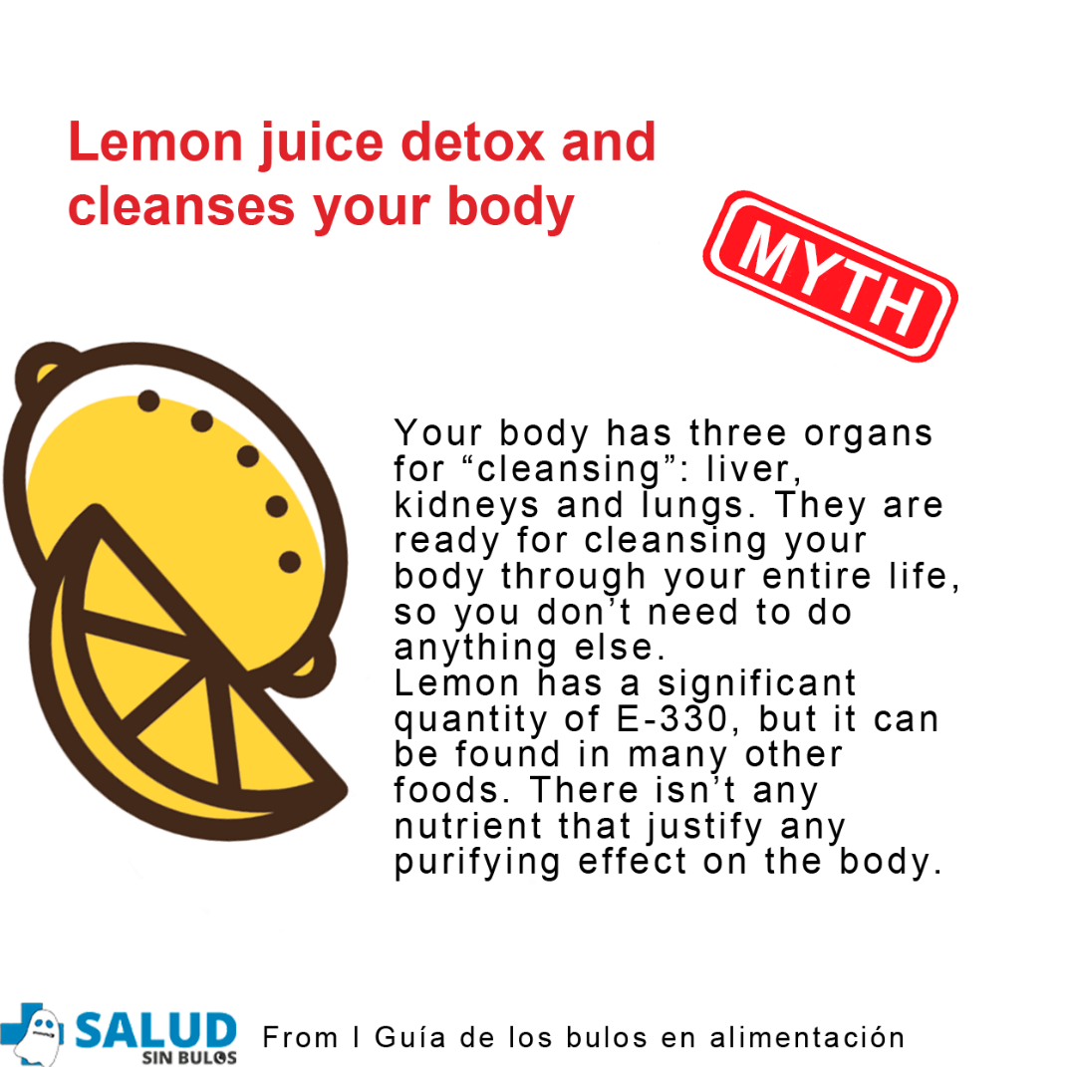
HOW DO HOAXES GO VIRAL?
Food

Slide 6
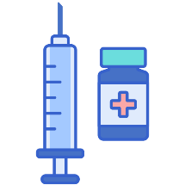
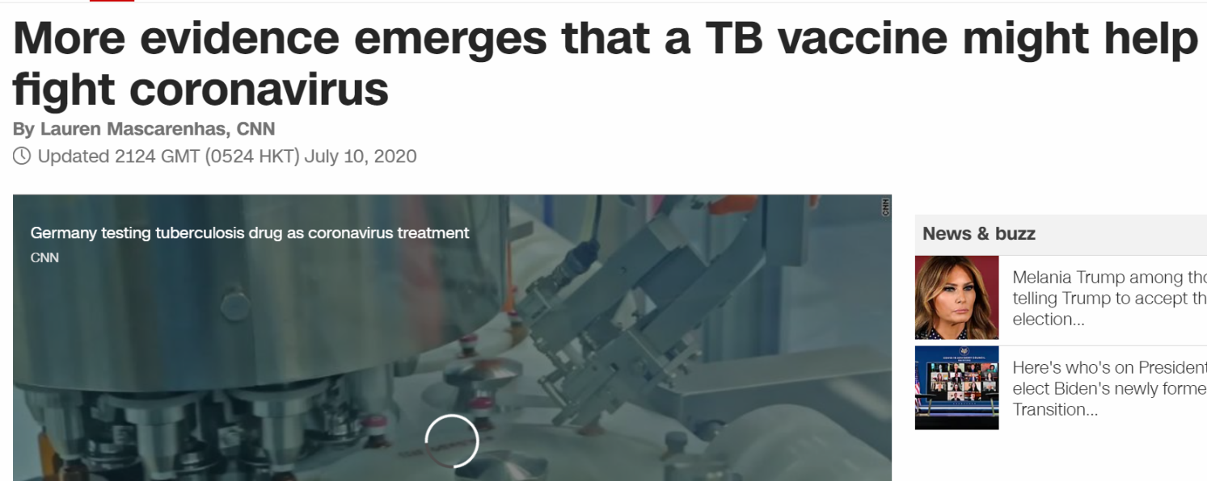
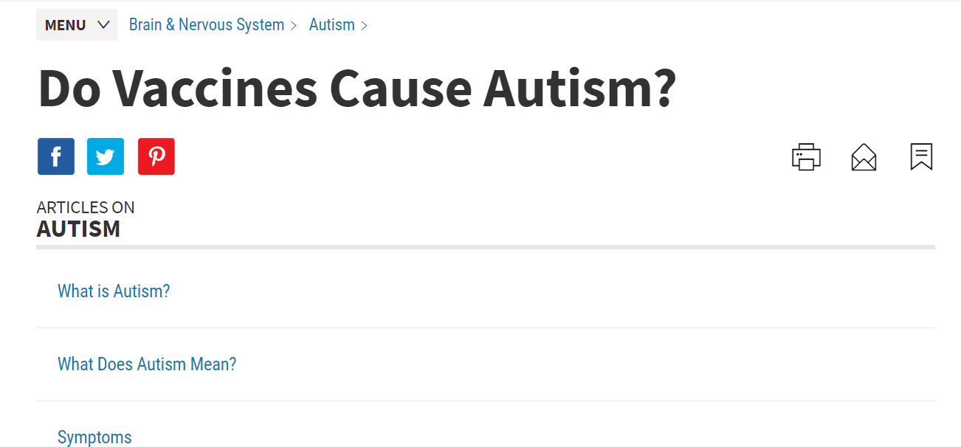
HOW DO HOAXES GO VIRAL?
FAKE
Vaccines
FAKE

Slide 7
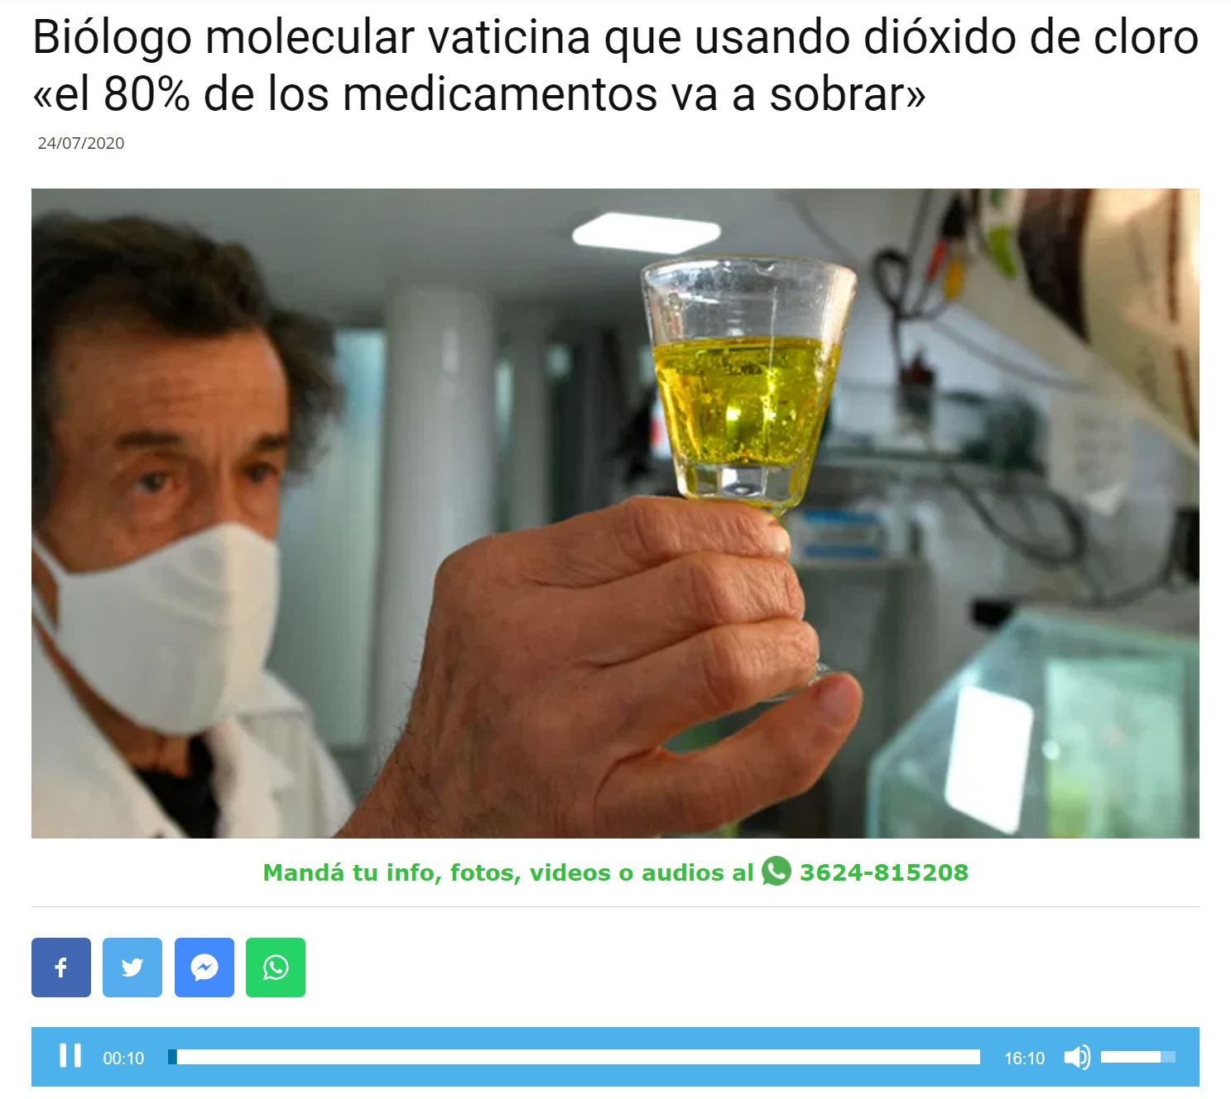
HOW DO HOAXES GO VIRAL?
Alternative therapies
FAKE

Slide 8
HOW DO HOAXES GO VIRAL?
Cancer
FAKE

Slide 9
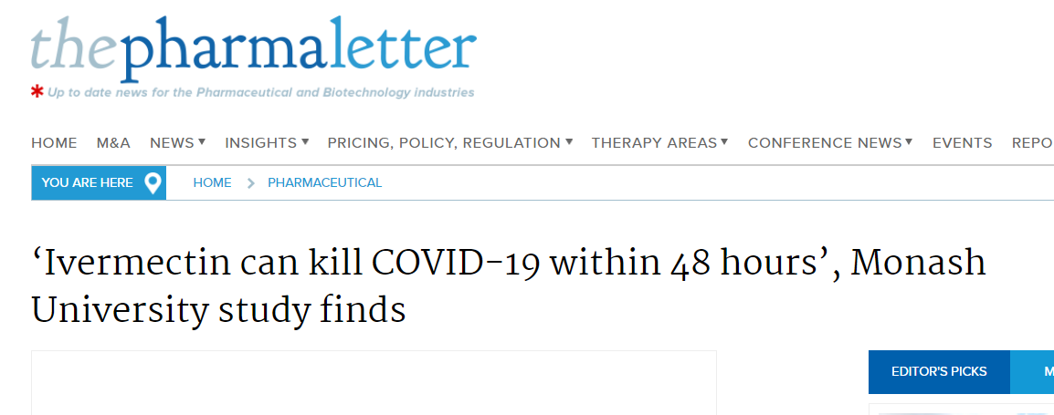
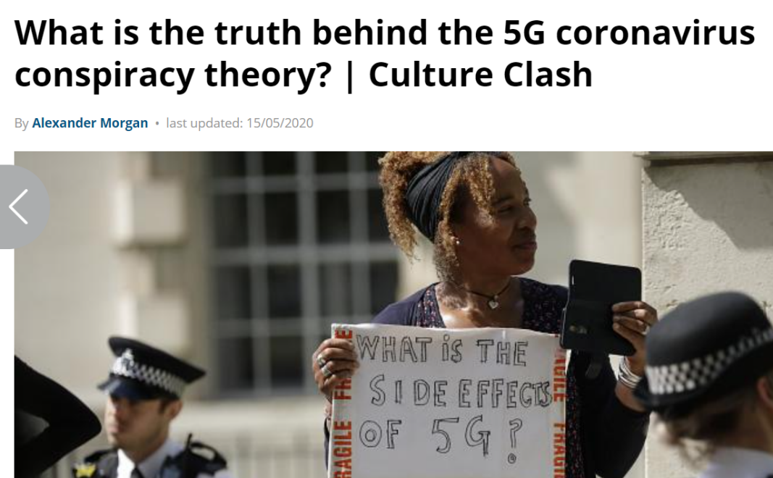
HOW DO HOAXES GO VIRAL?
COVID-19
FAKE
FAKE

Slide 10
MOTIVES BEHIND HEALTH HOAXES
Selling “miracle” products
Trying to help (without necessary background knowledge)
Harming a third person
Create social alarm
Fighting a specific ideology

Slide 11
HOW DO HOAXES GO VIRAL?
TODAS LAS PERSONAS SOMOS SUSCEPTIBLES
A CREERNOS UN BULO

Slide 12
HOW DO HOAXES GO VIRAL?
BIAS BLIND SPOT
Tendency to think that one is not conditioned by their beliefs, ideologies, desires or fears, but everyone else is.

Slide 13
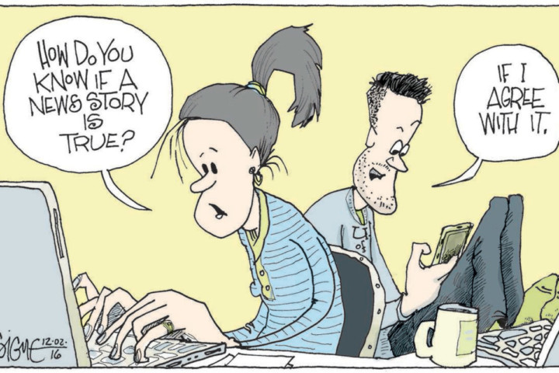
HOW DO HOAXES GO VIRAL?
CONFIRMATION BIAS
We give more importance and credibility to data that fits our beliefs

Slide 14
HOW DO HOAXES GO VIRAL?
HOMOPHILIA BIAS
We tend to read and listen to opinions that are like our own, so we believe that "everyone" thinks the way we do.

Slide 15
HOW DO HOAXES GO VIRAL?
TRUSTING THE SOURCE
We tend to give more credibility to information coming from a trusted source
This influencer
said that...
My friend, who is a doctor, told me
I’ve tried it and it worked for me
Donald Trump said it...

